Slide 1
Effective Strain Hardening Coefficient for Irradiated 9Cr ODS Alloy by Nano-Indentation and TEM
Corey Dolph¹
¹Wharry Group
Research Assistant
Boise State University

Slide 2
OBJECTIVE
Demonstrate the ability to characterize plastic deformation in nano-grained alloys
Determine the effect of irradiation exposure on the tensile properties of a 9Cr ODS steel

Slide 3
OVERVIEW
Background
Oxide Dispersion Strengthened (ODS) Steel
Irradiation Effects on Metals
Nano-Indentation
Characterization of Plastic Zone
Changes in Tensile Properties

Slide 4
BACKGROUND
Why the research interest in Oxide Dispersion Strengthened Steels?

Slide 5

BACKGROUND
Oxide Dispersion Strengthened Steel
[1]

Slide 6
BACKGROUND
Oxide Dispersion Strengthened Steel
Desire to develop future nuclear reactor designs that are:
Safer
More energy efficient
Proliferation resistant

Slide 7
BACKGROUND
Oxide Dispersion Strengthened Steel
Characteristics required for increased efficiency:
Resistance to thermal and irradiation creep
Adequate strength, ductility, and fatigue resistance
Resistance to radiation damage
Chemical stability

Slide 8
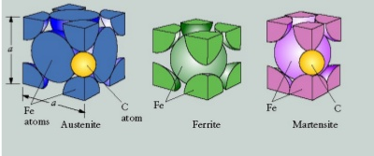
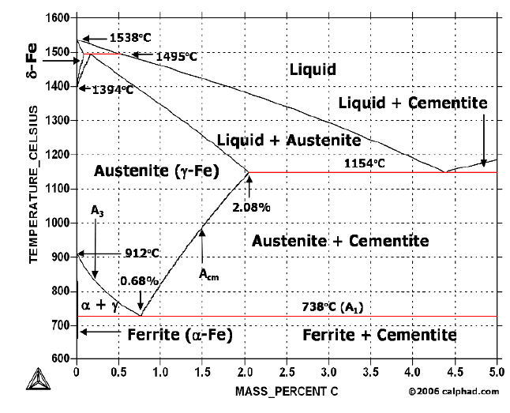
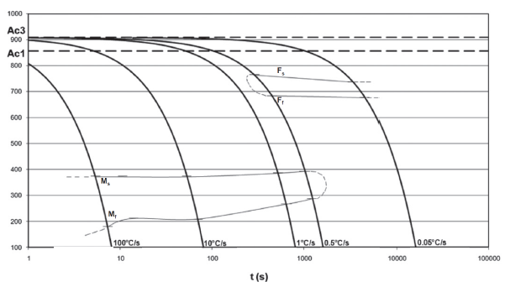
BACKGROUND
Oxide Dispersion Strengthened Steel
Ferritic Martensitic Steels
[2]
[3]

Slide 9
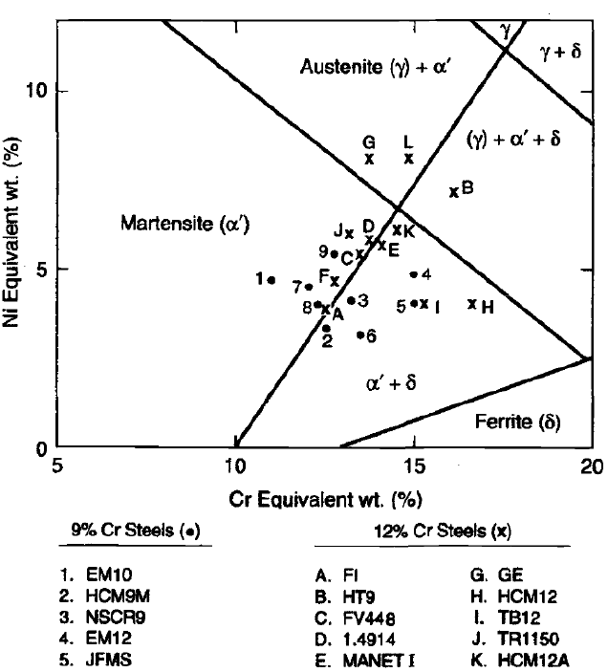
BACKGROUND
Oxide Dispersion Strengthened Steel
Ferritic Martensitic Steels
[2]
[4]
[3]

Slide 10
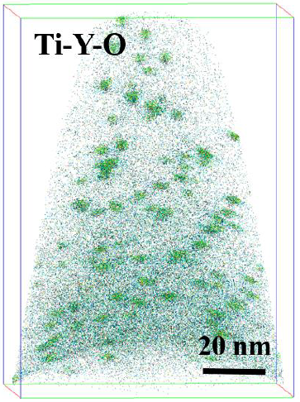
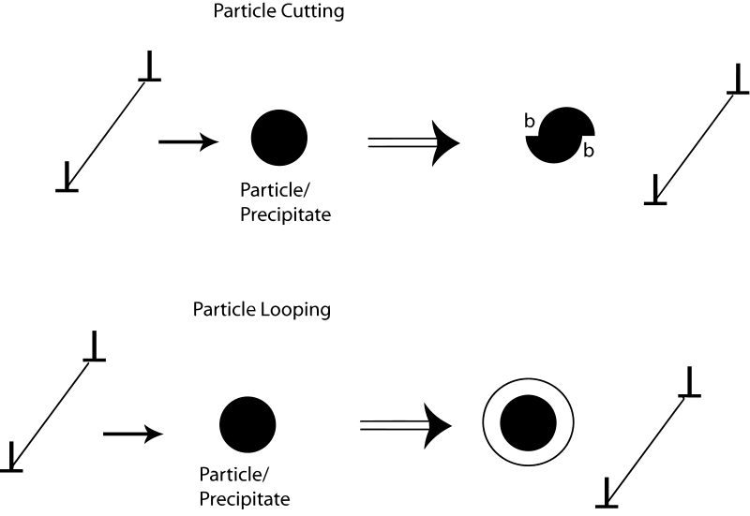
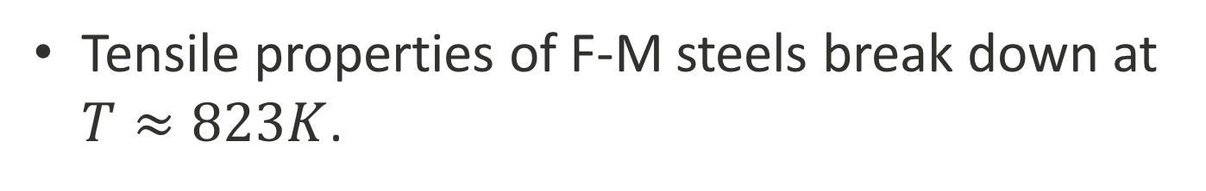
BACKGROUND
Oxide Dispersion Strengthened Steel
Tensile properties of F-M steels break down at $T≈823K$.
[5]

Slide 11
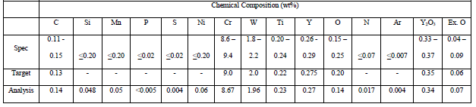
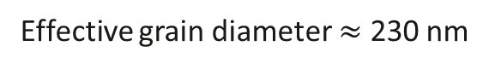
BACKGROUND
Oxide Dispersion Strengthened Steel
Final Heat Treatments
1050°C x 1 h
800°C x 1 h
Effective grain diameter $≈$ 230 nm
[5]

Slide 12
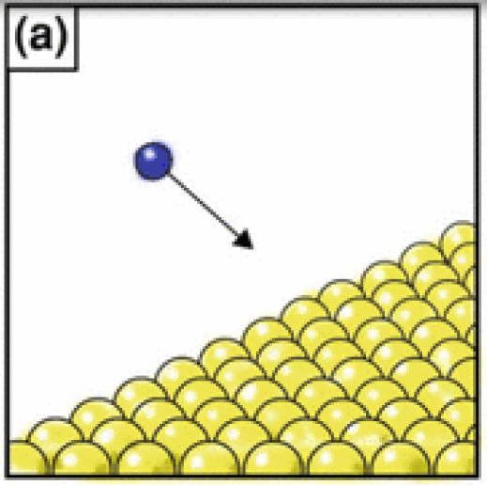
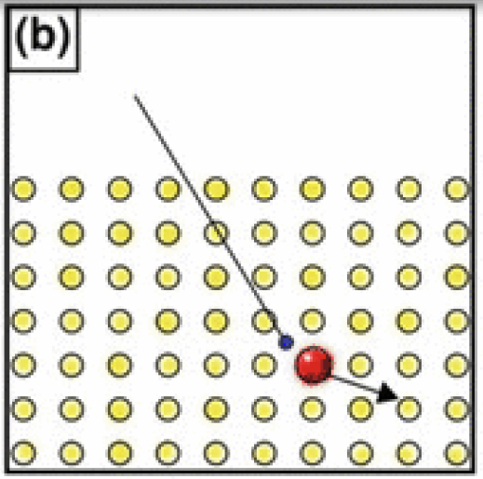
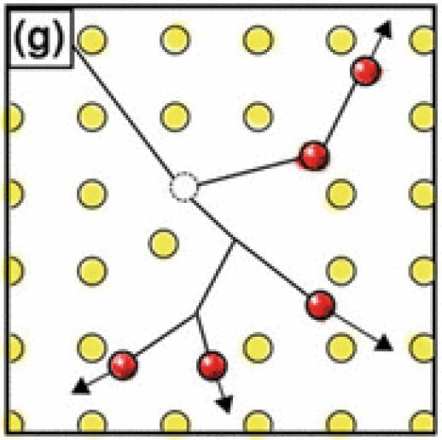
BACKGROUND
Irradiation Effects
[6]

Slide 13
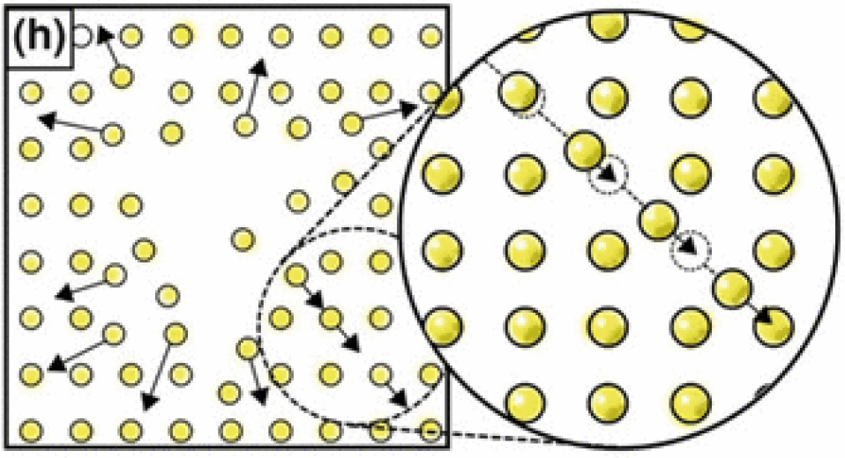
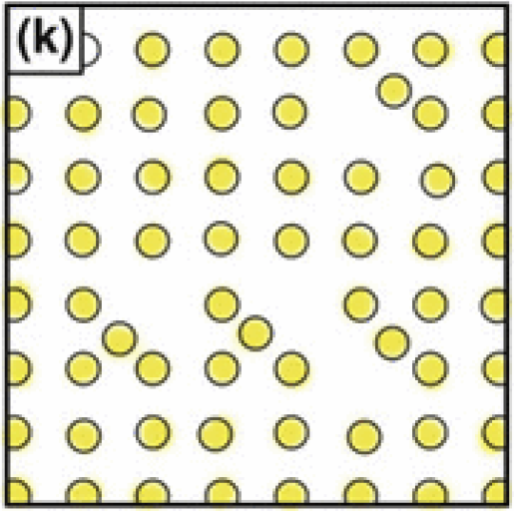
BACKGROUND
Irradiation Effects
[6]

Slide 14
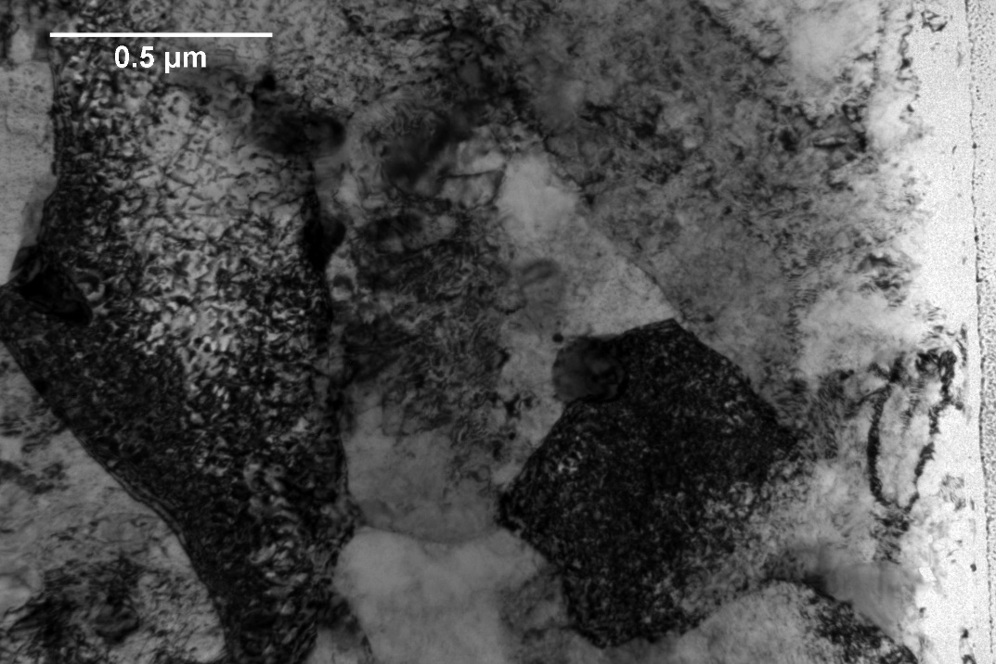
BACKGROUND
Irradiation alters the microstructure:
Point defects
Precipitates
Oxide Instability
Chemical Segregation
Results in changes in material properties
Precipitates
Dislocation Network

Slide 15
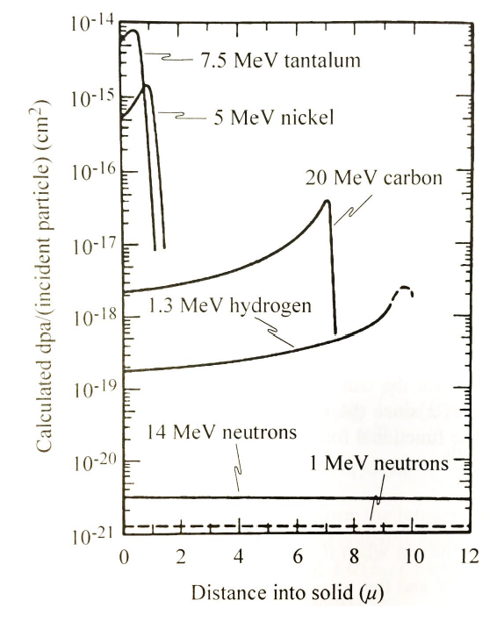
BACKGROUND
Irradiation Effects
[7]

Slide 16
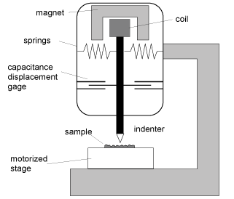
BACKGROUND
Nano-Indentation
Error
Creep
Thermal Drift
Surface Roughness
The Curve
Loading
Maximum Load
Unloading
Uses
Hardness
Elastic modulus
Strain hardening index
Fracture toughness
Yield strength
Specifications
Two modes of Control
Load
Displacement

Slide 17
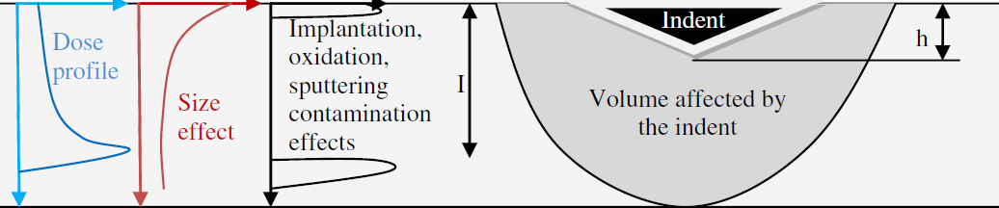
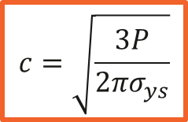
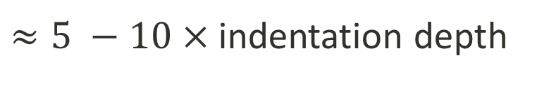
BACKGROUND
Nano-Indentation
[8]
Johnson’s Model
$$c=\sqrt{\frac{3P}{2πσ_{ys}}}$$
$≈5 −10×$indentation depth

Slide 18
Experimental APPROACH
Irradiate the Samples
Perform Nano-Indentation
Determine Plastic Zone
Determine Tensile Properties

Slide 19
Experimental APPROACH
Irradiate the Samples
Perform Nano-Indentation
Determine Plastic Zone
Determine Tensile Properties
Three Test Conditions:
Ion Irradiated
Neutron Irradiated
As Received

Slide 20
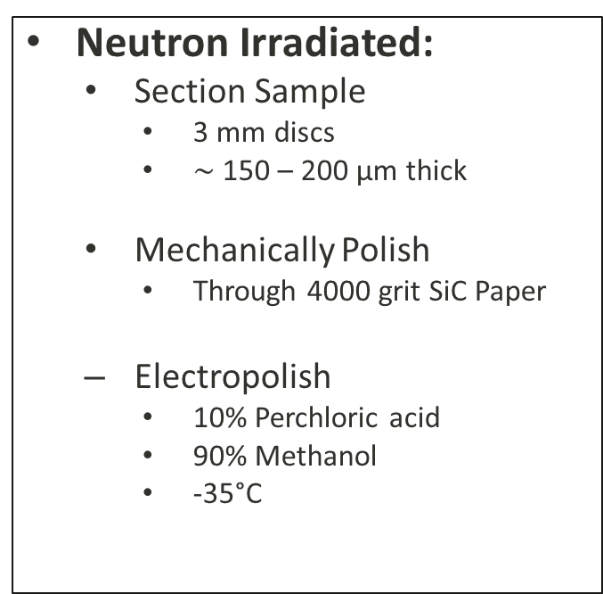
IRRADIATIONS
Sample Preparation
Ion Irradiated:
Section Sample
20mm x 2mm x 2mm bar
Mechanically Polish
Through 4000 grit SiC Paper
Electropolish
10% Perchloric acid
90% Methanol
20 seconds
-40°C
35 V
Neutron Irradiated:
Section Sample
3 mm discs
$∼$ 150 – 200 μm thick
Mechanically Polish
Through 4000 grit SiC Paper
Electropolish
10% Perchloric acid
90% Methanol
-35°C

Slide 21
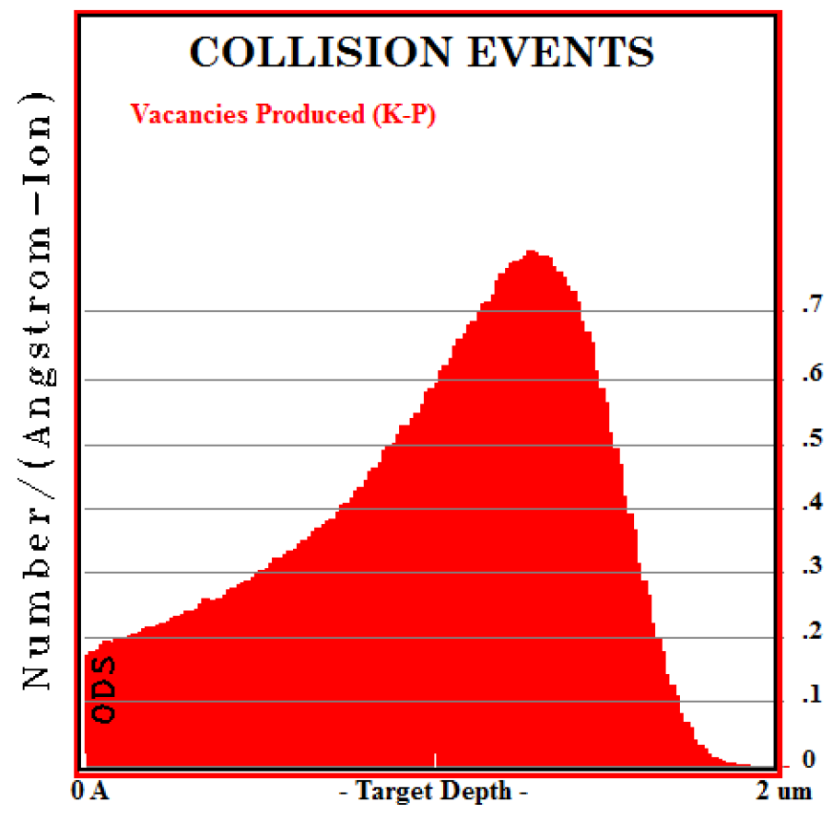
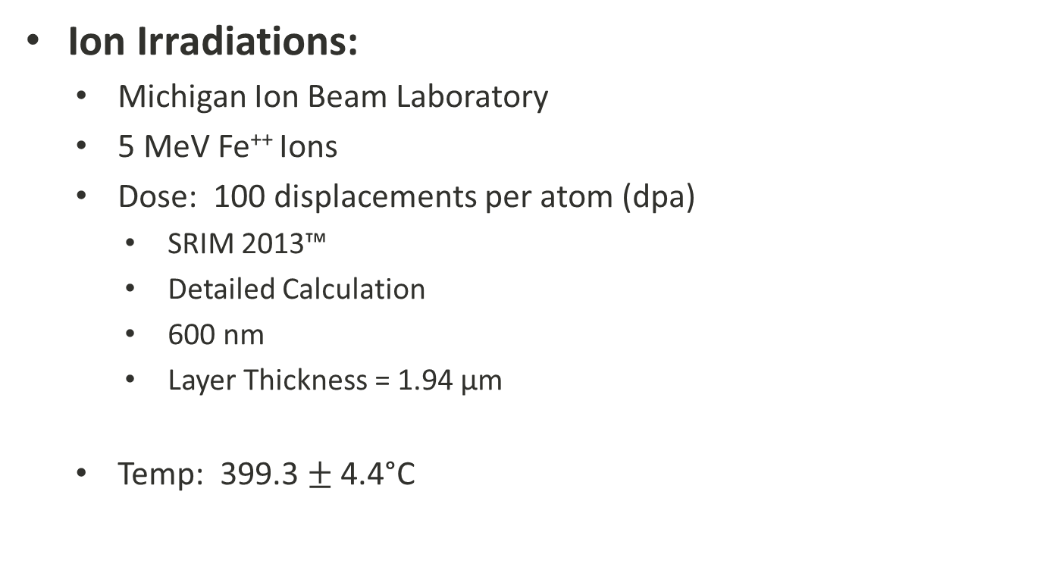
IRRADIATIONS
Ion Irradiations:
Michigan Ion Beam Laboratory
5 MeV Fe⁺⁺ Ions
Dose: 100 displacements per atom (dpa)
SRIM 2013™
Detailed Calculation
600 nm
Layer Thickness = 1.94 μm
Temp: 399.3 $±$ 4.4°C
dpa
237
199
142
100
85
28
0
Depth (nm)
2000
600
1280

Slide 22
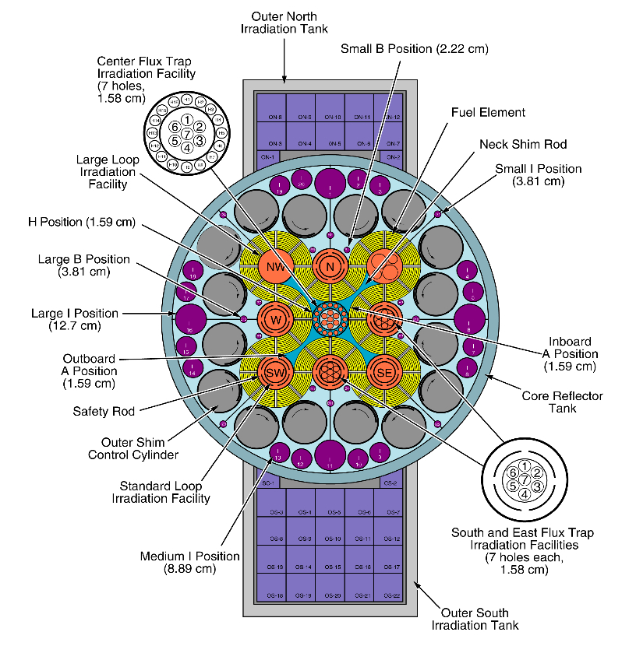
IRRADIATIONS
Neutron Irradiations:
Advanced Test Reactor (ATR) at Idaho National Lab
Dose: 3 dpa
Temp: 500°C
[9]

Slide 23
Experimental APPROACH
Irradiate the Samples
Perform Nano-Indentation
Determine Plastic Zone
Determine Tensile Properties

Slide 24
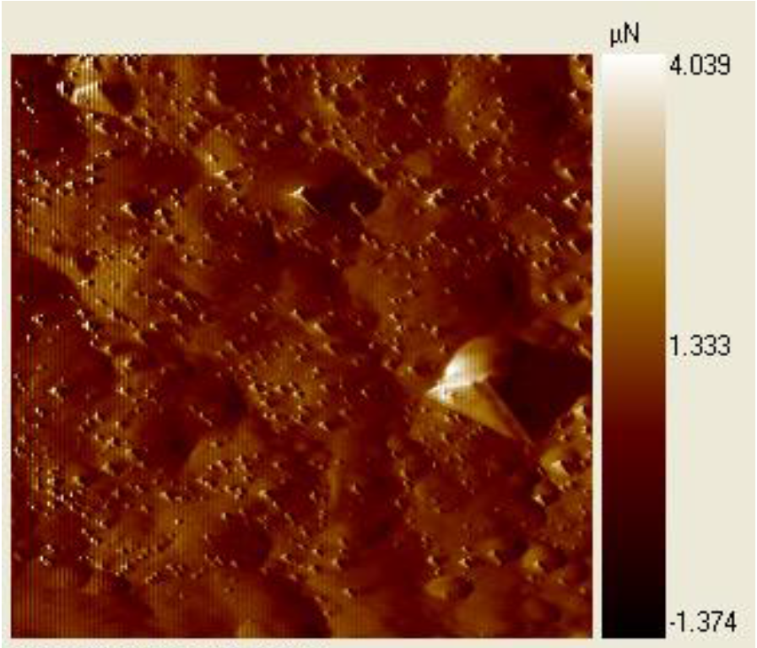
NANO-INDENTATION
Sample Preparation
As Received
Section Sample
Allied Techcut 4™ Diamond Saw
Mechanically Polish
Allied-M prep B™
Through 1200 grit SiC Paper
Buehler MetaDi™ Poly Crystalline Diamond Suspension through 0.05μm
Electropolish
10% Perchloric acid
90% Methanol
20 Seconds
-40°C
35 V
Surface Roughness: 57.83 nm
Peak to Valley: 290.77 nm

Slide 25
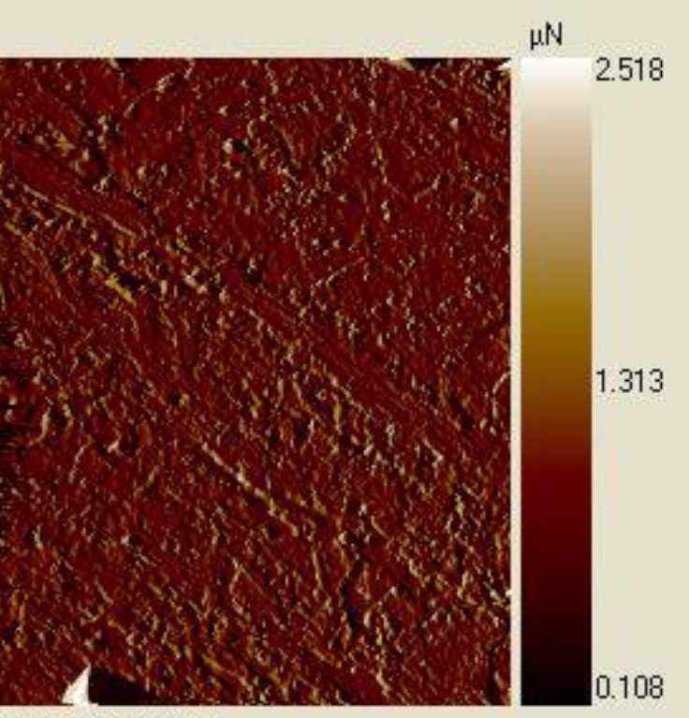
NANO-INDENTATION
Sample Preparation
Neutron Irradiated
Electropolish
5% Perchloric acid
95% Methanol
5 Seconds
-45°C
80 V
Surface Roughness: 52.23 nm
Peak to Valley: 244.72 nm

Slide 26
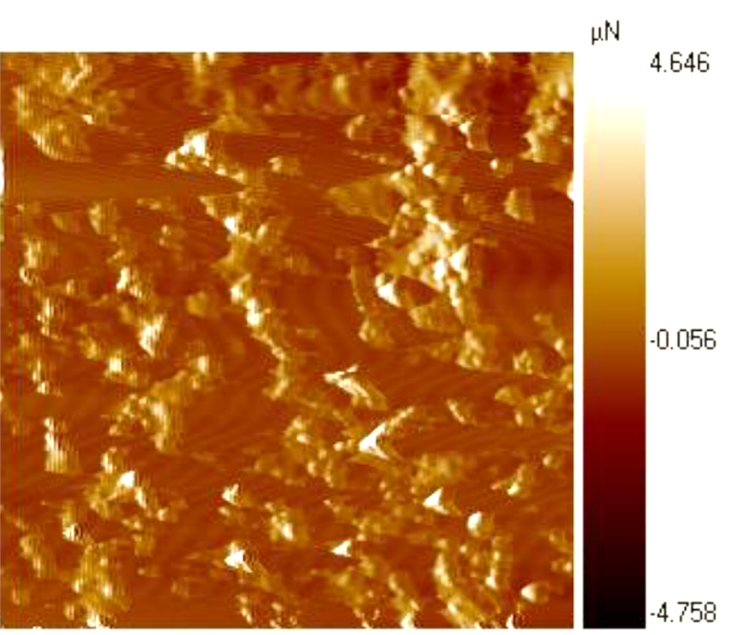
NANO-INDENTATION
Sample Preparation
Ion Irradiated
No Polishing Performed
Prevent loss of irradiated layer
Surface Roughness: 100.172 nm
Peak to Valley: 732.387 nm

Slide 27
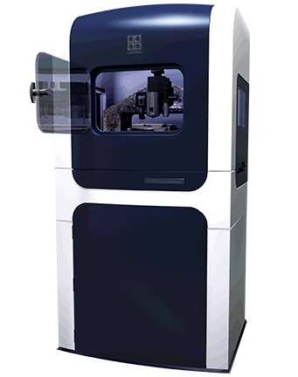
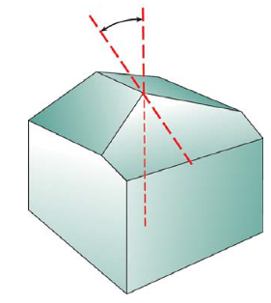
NANO-INDENTATION
Hysitron TI-950
MaCS Lab, CAES
Depth Control
High Load Berkovich Indenter
65.3°
[11]
[10]

Slide 28


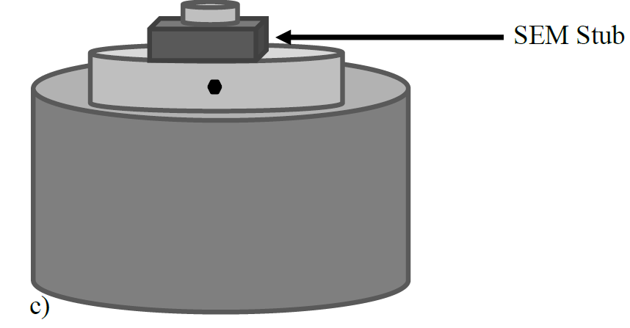
NANO-INDENTATION
Sample Mounts
Ion Irradiated
As Received
Neutron Irradiated

Slide 29
Experimental APPROACH
Irradiate the Samples
Perform Nano-Indentation
Determine Plastic Zone
Determine Tensile Properties

Slide 30
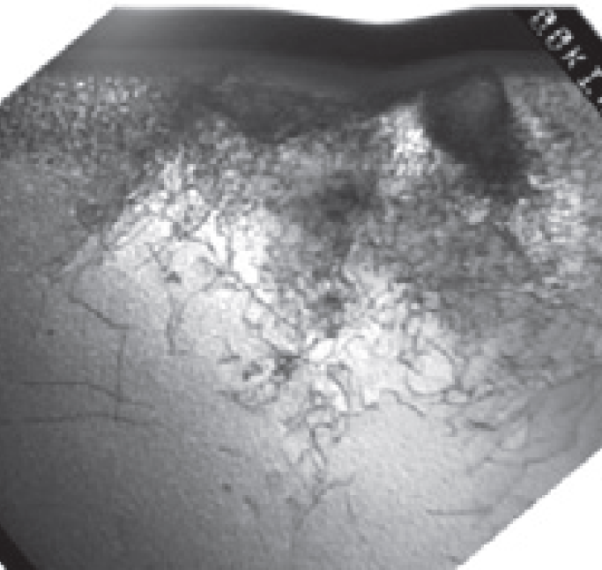
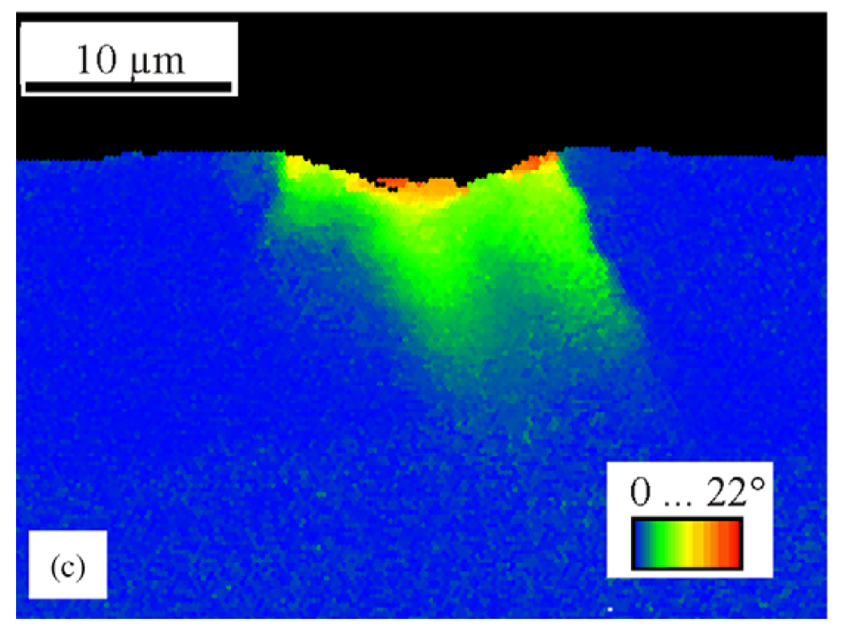
PLASTIC DEFORMATION
Dislocation Imaging
Orientation Mapping
[12]
[13]

Slide 31
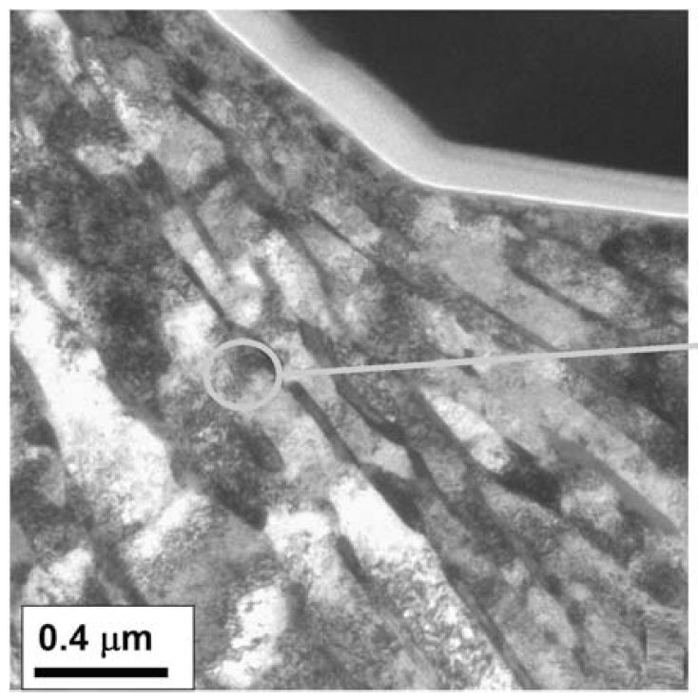
PLASTIC DEFORMATION
Polycrystalline Irradiated Material
[14]

Slide 32
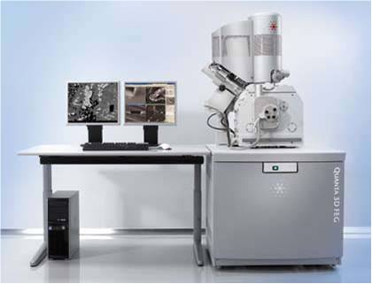
PLASTIC DEFORMATION
TEM Sample Preparation
FOCUSED ION BEAM
FEI Quanta™ 3D FEG
MaCS Lab (CAES)
[15]

Slide 33
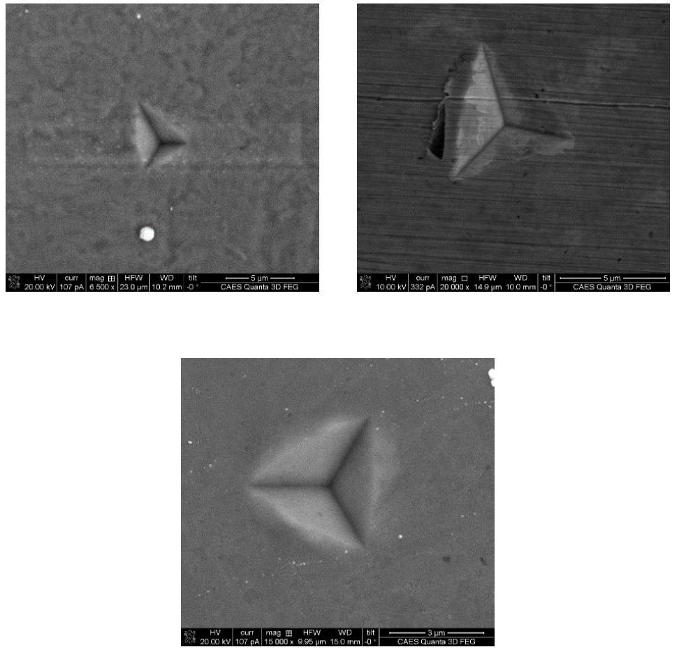
PLASTIC DEFORMATION
TEM Sample Preparation
As Received
Ion Irradiated
Neutron Irradiated

Slide 34
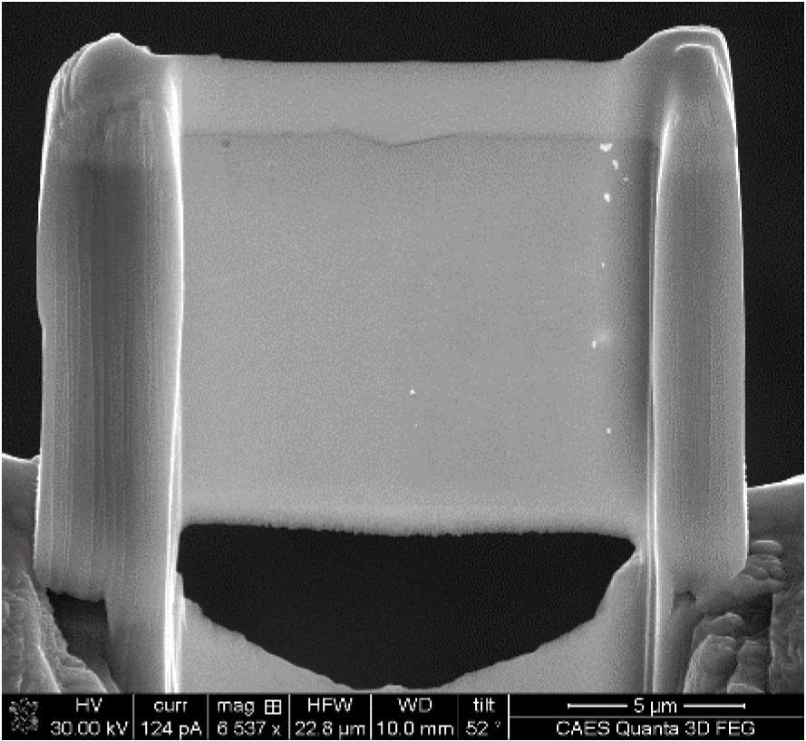
PLASTIC DEFORMATION
TEM Sample Preparation

Slide 35

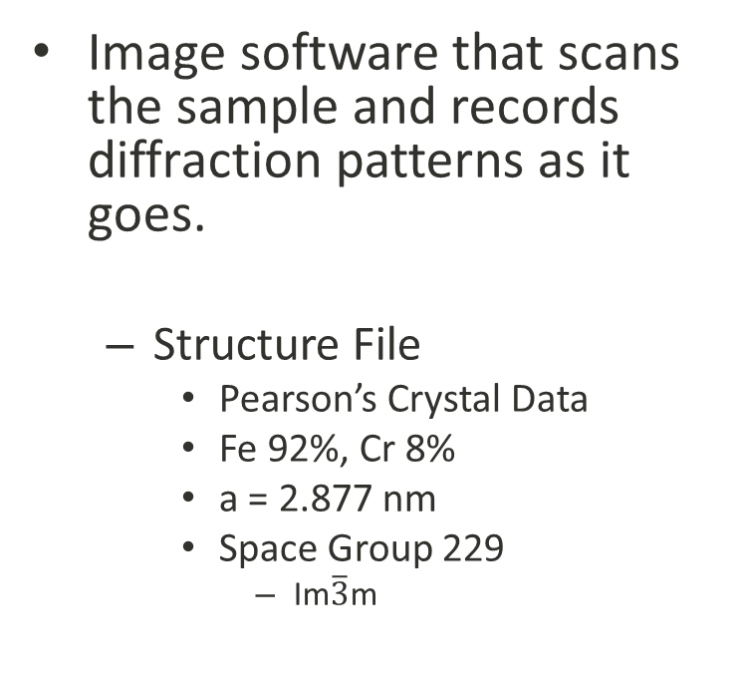
PLASTIC DEFORMATION
ASTAR Imaging
Image software that scans the sample and records diffraction patterns as it goes.
Structure File
Pearson’s Crystal Data
Fe 92%, Cr 8%
a = 2.877 nm
Space Group 229
Im$\overline{3}$m

Slide 36
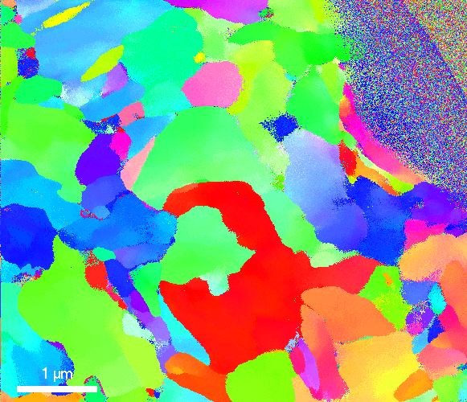
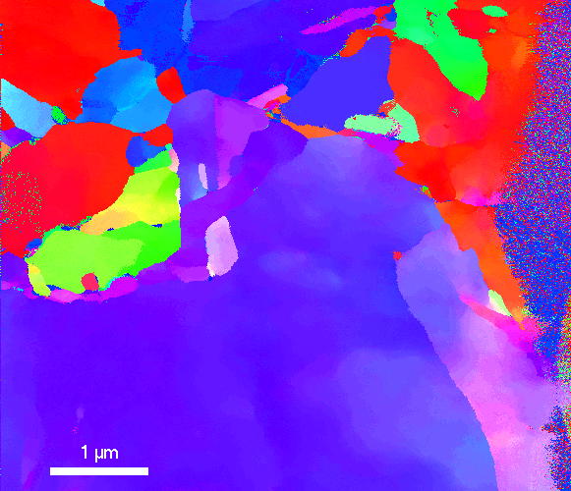
PLASTIC DEFORMATION
ASTAR Imaging
Neutron Irradiated
As Received

Slide 37
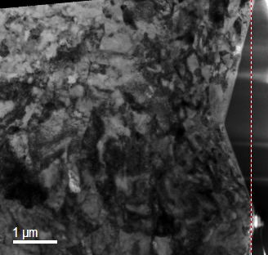
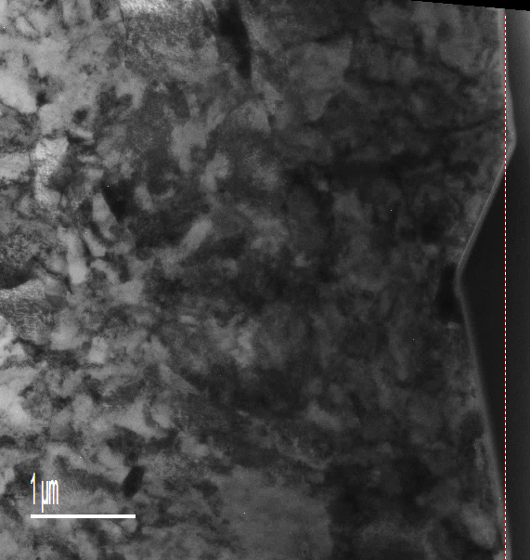
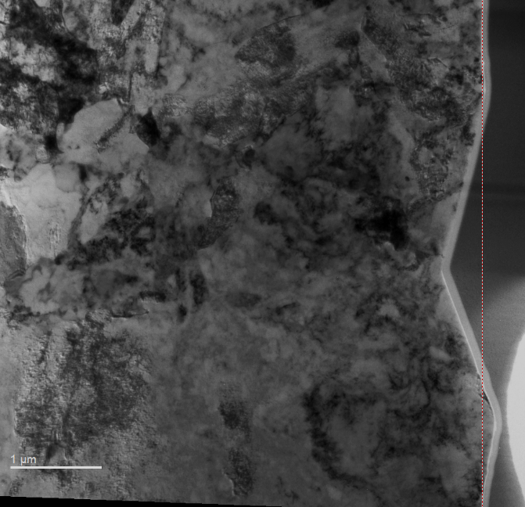
PLASTIC DEFORMATION
TEM Imaging
1 μm
1 μm
1 μm
Ion Irradiated
Neutron Irradiated
As Received

Slide 38
PLASTIC DEFORMATION
TEM Imaging
1 μm
1 μm
1 μm
Ion Irradiated
Neutron Irradiated
As Received

Slide 39
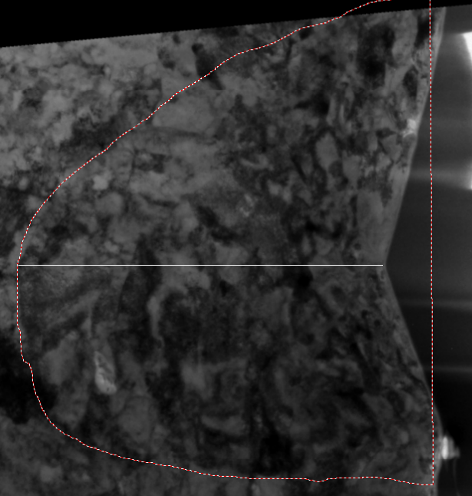
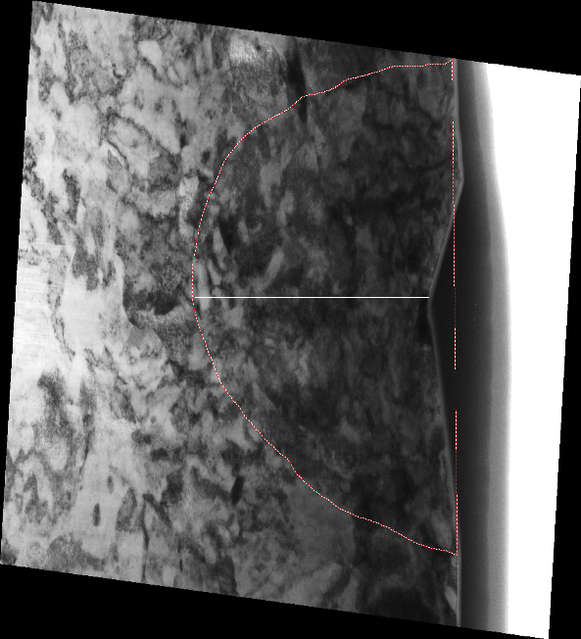
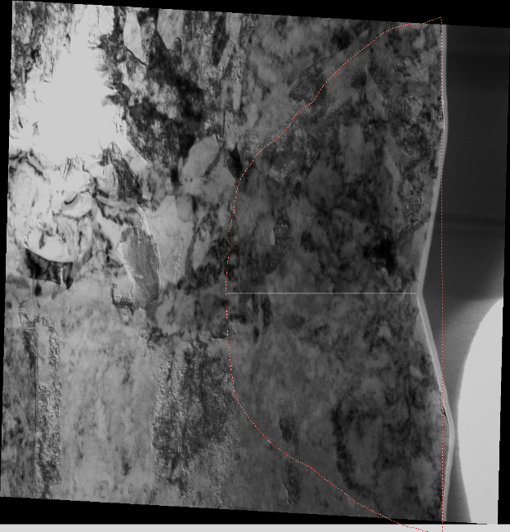
PLASTIC DEFORMATION
3.679 μm
4.181 μm
3.297 μm
Ion Irradiated
Neutron Irradiated
As Received
Johnson’s Model
 | Plastic Zone (μm) | Percent Difference
Ion Irradiated | 4.33 | 3.5%
Neutron Irradiated | 3.79 | 3.0%
As Received | 3.17 | 3.9%

Slide 40
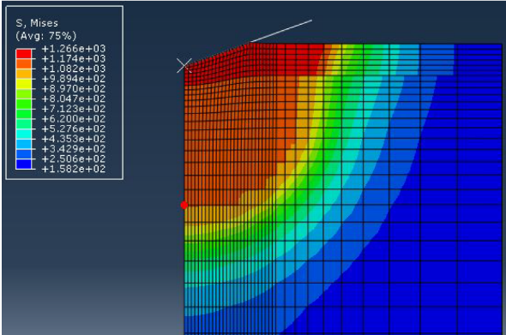
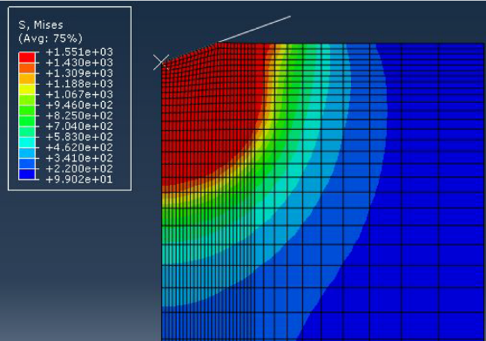
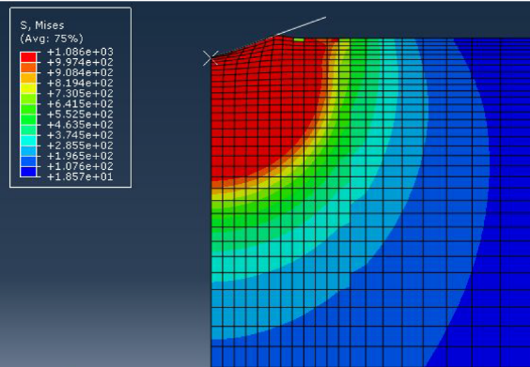
PLASTIC DEFORMATION
3.679 μm
4.181 μm
3.297 μm
Ion Irradiated
Neutron Irradiated
As Received
4.380 μm
3.758 μm
3.129 μm

Slide 41
PLASTIC DEFORMATION
Summary
ASTAR imaging demonstrates non-uniform orientation between grains
Plastic zone in polycrystalline materials can be imaged through bright field TEM.
For 9Cr ODS ratio of plastic zone to indentation depth is:

Slide 42
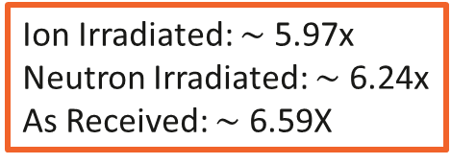
PLASTIC DEFORMATION
Summary
ASTAR imaging demonstrates non-uniform orientation between grains
Plastic zone in polycrystalline materials can be imaged through bright field TEM.
For 9Cr ODS ratio of plastic zone to indentation depth is:
Ion Irradiated: $∼$ 5.97x
Neutron Irradiated: $∼$ 6.24x
As Received: $∼$ 6.59X

Slide 43
Experimental APPROACH
Irradiate the Samples
Perform Nano-Indentation
Determine Plastic Zone
Determine Tensile Properties

Slide 44
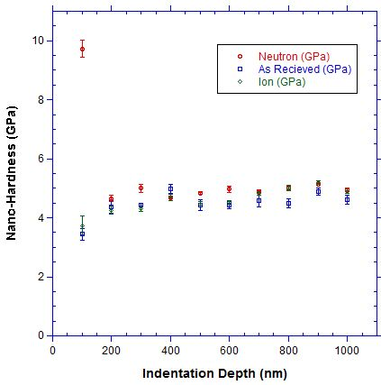
TENSILE PROPERTIES
Nano-Hardness (GPa)
Indentation Depth (nm)

Slide 45
TENSILE PROPERTIES
As Received
Surface Effects:
Nano-Hardness (GPa)
Indentation Depth (nm)

Slide 46



TENSILE PROPERTIES
As Received
Surface Effects:
$$depth$$
$$Hardness↓ =\frac{Load↓}{Contact Area↑}$$
$$depth$$

Slide 47



TENSILE PROPERTIES
As Received
Surface Effects:
$$depth$$
$$Hardness↓ =\frac{Load↓}{Contact Area↑}$$
$$r≈200 nm$$
$$depth$$

Slide 48
TENSILE PROPERTIES
As Received
Surface Effects:
Nano-Hardness Range:
Elastic Modulus Range:
Nano-Hardness (GPa)
4.43 – 4.99 GPa
210.40 – 226.42 GPa
Indentation Depth (nm)

Slide 49
TENSILE PROPERTIES
Neutron Irradiated
Indentation Size Effect
Nano-Hardness Range:
Nano-Modulus Range:
Nano-Hardness (GPa)
4.67 – 5.14 GPa
216.83 – 227.51 GPa
Indentation Depth (nm)

Slide 50



TENSILE PROPERTIES
Neutron Irradiated
Irradiation Hardening (GPa)
$$Average Hardening =262.39 MPa$$
$$Yield Strength Increase≈81.87 GPa$$
Indentation Depth (nm)

Slide 51
TENSILE PROPERTIES
Ion Irradiated
Surface Effects
Nano-Hardness Range:
Nano-Modulus Range:
Nano-Hardness (GPa)
4.31 – 5.19 GPa
188.62 – 197.70 GPa
Indentation Depth (nm)

Slide 52




TENSILE PROPERTIES
Ion Irradiated
Irradiation Softening occurs at depths less than 500 nm
Hardening increases until approaches neutron hardening at $≈$ 700 nm
Irradiation Hardening (GPa)
$$Average Hardening =285.03 MPa$$
$$Yield Strength Increase≈88.94 GPa$$
Indentation Depth (nm)

Slide 53

TENSILE PROPERTIES
Validation of Ion Irradiated
Microstructure (Swenson)
 | Ion |  | Neutron
 | Density (m⁻²) | Diameter (nm) | Density (m⁻²) | Diameter (nm)
Dislocation Lines | 2.04 x 10¹⁵ | - | 1.85 x 10¹⁵ | -
Carbides | 1.7 x 10¹⁹ | 0.09 | 4.7 x 10¹⁹ | 0.10
Nano-Clusters | 3.85 x 10²³ | 2.20 | 4.35 x 10²³ | 1.91
Voids | 4.6 x 10²⁰ | 7.46 | 2.4 x 10²⁰ | 3.64
Dislocation Loops | 3.1 x 10²¹ | 21.5 | 2.7 x 10²¹ | 9.5
Nano-Indentation
 | Ion | Neutron
ΔH_{ave}(MPa) | 285.03 | 262.39
Δσ_{ys} (GPa) | 88.94 | 81.87
$$∆σ_{ys}∝\sqrt{Nd}$$
[7]
N = Number density of the obstacle (#/m³)
d = Average diameter of the obstacles (nm)

Slide 54



TENSILE PROPERTIES
Stress Strain Curve
$$σ=\left\{\begin{matrix}Eε \\ Kε^{n}\end{matrix}\right.$$
[16]
$σ=stress$
$E=Young^{′}s Modulus$
$ε=strain$
$n=strain hardening coefficient$
$K=strength coefficeint$
[8]

Slide 55





TENSILE PROPERTIES
Stress Strain Curve
$$\frac{H}{σ_{r}}=f\left[\frac{2}{3}\right]{\left(\frac{ε_{ys}}{0.1}\right)}^{n}+Θ\left(n\right)+M(n){\left(\frac{z_{ys}+1.217a_{s}}{{a_{s}}/{0.635}}\right)}^{\left.P(n\right)}$$
[17]
$H=nano hardness$
$σ_{r}=uniaxial stress at ε=0.1$
$f=Berkovich factor=1.101$
$Θ\left(n\right)=2.5968+\frac{0.5097}{n}$
$M\left(n\right)=−2.2778−\frac{0.5479}{n}$
$P\left(n\right)=−3.0615 n−0.005$
$z_{ys}=depth of plastic zone$
$a_{s}=contact radius$
$$σ_{r}=\frac{H}{2.7}$$
[9]

Slide 56


TENSILE PROPERTIES
Stress Strain Curve
neutron
True Stress (MPa)
ion
 | $$n$$
As Received | 0.205
Neutron | 0.340
Ion | 0.305
as received
True Strain

Slide 57
TENSILE PROPERTIES
Summary
Irradiation induced hardening is observed in both the neutron and ion irradiated samples
Extent of hardening is consistent with microstructure
The plastic deformation is altered by the irradiation effects, as demonstrated by the effective strain hardening coefficient

Slide 58
CONCLUSIONS
Plastic deformation in polycrystalline materials can be characterized through TEM bright field imaging.
Irradiation induced hardening is observed in 9Cr ODS under ion irradiation at 400°C, and neutron irradiation at 500°C.
Possible ultimate tensile strength is altered by irradiation as shown by increases in the strain hardening coefficient of 49% and 39% for the neutron and ion irradiation conditions, respectively.
Indentation sample volume influences on tensile properties are more prominent in the region of plastic deformation than in the elastic region.

Slide 59
REFERENCES
[1] M. Roser, “World Population Growth,” OurWorldINData.org, 2015. [Online]. Available: http://ourworldindata.org/data/population-growth-vital-statistics/world-population-growth/. [Accessed: 28-Jul-2015].
[1] https://atrnsuf.inl.gov/, 2015.
[2] http://www.slideshare.net/ranasajjad484/iron-carbon-dia-presentation, 2015
[3] L. Toualbi, C. Cayron, P. Olier, J. Malaplate, M. Praud, M.-H. Mathon, D. Bossu, E. Rouesne, a. Montani, R. Logé, and Y. de Carlan, “Assessment of a new fabrication route for Fe–9Cr–1W ODS cladding tubes,” J. Nucl. Mater., vol. 428, no. 1–3, pp. 47–53, Sep. 2012.
[4] R. L. Klueh and D. R. Harries, High-Chromium Ferritic and Martensitic Steels for Nuclear Applications. ASTM Int’l, 2011.
[5] A. R.R and D. Jaramillo, “Precipitation adn mechanical properties of aluminum alloys,” in Mechanical Behavior of Precipitation Hardened Aluminum Alloys Welds, Light Metal Alloys Applications, Intech, 2014.
[6] C. Race, The Modelling of Radiation Damage in Metals Using Ehrenfest Dynamics, 2011th ed. Berlin, Heidelberg: Springer Berlin Heidelberg, 2010.
[7] G.S. Was, Fundamentals of Radiation Materials Science: Metals and Alloys. 2007.
[8] P. Hosemann, D. Kiener, Y. Wang, and S. a. Maloy, “Issues to consider using nano indentation on shallow ion beam irradiated materials,” J. Nucl. Mater., vol. 425, no. 1–3, pp. 136–139, Jun. 2012.
[9] https://atrnsuf.inl.gov/, 2015
[10] https://www.hysitron.com/products-services/standalone-instruments/ti-950-triboindenter, 2015
[12] D. Hardie, S.G. Roberts, “Nanoindentation of model Fe-Cr alloys with self-ion irradiation,” Journal of Nuclear Materials, vol. 433, pp.174-179, 2013.
[13] D. Kiener, R. Pippan, C. Motz, and H. Kreuzer, “Microstructural evolution of the deformed volume beneath microindents in tungsten and copper,” Acta Mater., vol. 54, no. 10, pp. 2801–2811, 2006.
[14] B. Bose, R.J. Klassen, “Effect of ion irradiation and indentation depth on the kinetics of deformation during micro-indentation of Zr-2.5%Nb pressure tube material at 25°C,” Journal of Nuclear Materials, vol. 399, pp. 32-37, 2010.
[15] http://www.birmingham.ac.uk/facilities/electron-microscopy/microscopes/index.aspx, 2015.
[16] C. Robertson, B. K. Panigrahi, S. Kataria, Y. Serruys, M. H. Mathon, and C. S. Sundar, “Particle stability in model ODS steels irradiated up to 100 dpa at 600C: TEM and nano-indentatin investigation,” J. Nucl. Mater., vol. 426, pp. 240–246, 2012.
[17] M. Mata, O. Casals, and J. Alcalá, “The plastic zone size in indentation experiments: The analogy with the expansion of a spherical cavity,” Int. J. Solids Struct., vol. 43, no. 20, pp. 5994–6013, Oct. 2006.
[18] L.A. Giannuzzi, F.A. Stevie, “A review of focused ion beam milling techniques for TEM specimen preparation, “Micron,” vol. 30, pp. 197-204, 1999.

Slide 60
Thank You
Corey Dolph, Research Assistant
Email: coreydolph@boisestate.edu

Slide 61

FIB Operation
FOCUSED ION BEAM
Operates like a SEM
Ga⁺ Ion Beam
Low melting point (85.6°F)
Fine probe size (< 10 nm)
Electron Beam
[18]

Slide 62

PLASTIC DEFORMATION
TEM Sample Preparation
Electron beam platinum deposition
Rectangle
5.0 kV
3.0 nA
z = 0.3 μm

Slide 63

PLASTIC DEFORMATION
TEM Sample Preparation
Ion beam platinum deposition
Rectangle
30.0 kV
0.5 nA
z = 4.0 μm

Slide 64

PLASTIC DEFORMATION
TEM Sample Preparation
Trench Cut
Regular Cross Section
30.0 kV
15.0 nA
z = 15.0 μm

Slide 65

PLASTIC DEFORMATION
TEM Sample Preparation
Trench Cut
Cleaning Cross Section
30.0 kV
7.0 nA
z = 7.0 μm

Slide 66

PLASTIC DEFORMATION
TEM Sample Preparation
U cuts
Rectangle
30.0 kV
5.0 nA

Slide 67

PLASTIC DEFORMATION
TEM Sample Preparation
Mount to grid
Pt welds using Omniprobe
30.0 kV
50.0 pA

Slide 68
PLASTIC DEFORMATION
TEM Sample Preparation
Thinning
Cleaning Cross Section
30.0 kV
3.0 nA
~ 1 μm

Slide 69
PLASTIC DEFORMATION
TEM Sample Preparation
Thinning
Cleaning Cross Section
30.0 kV
1.0 nA
~ 500 nm

Slide 70
PLASTIC DEFORMATION
TEM Sample Preparation
Thinning
Cleaning Cross Section
30.0 kV
0.3 nA
~ 250 nm

Slide 71
PLASTIC DEFORMATION
TEM Sample Preparation
Thinning
Cleaning Cross Section
30.0 kV
0.1 nA
~ 100 nm

Slide 72
PLASTIC DEFORMATION
TEM Sample Preparation
Final Thinning
Rectangle
5.0 kV
77.0 pA

Slide 73
PLASTIC DEFORMATION
TEM Sample Preparation
Final Thinning
Rectangle
2.0 kV
48.0 pA

Slide 74

Evolution of Plastic Zone
100 nm
200 nm

